Slide 1
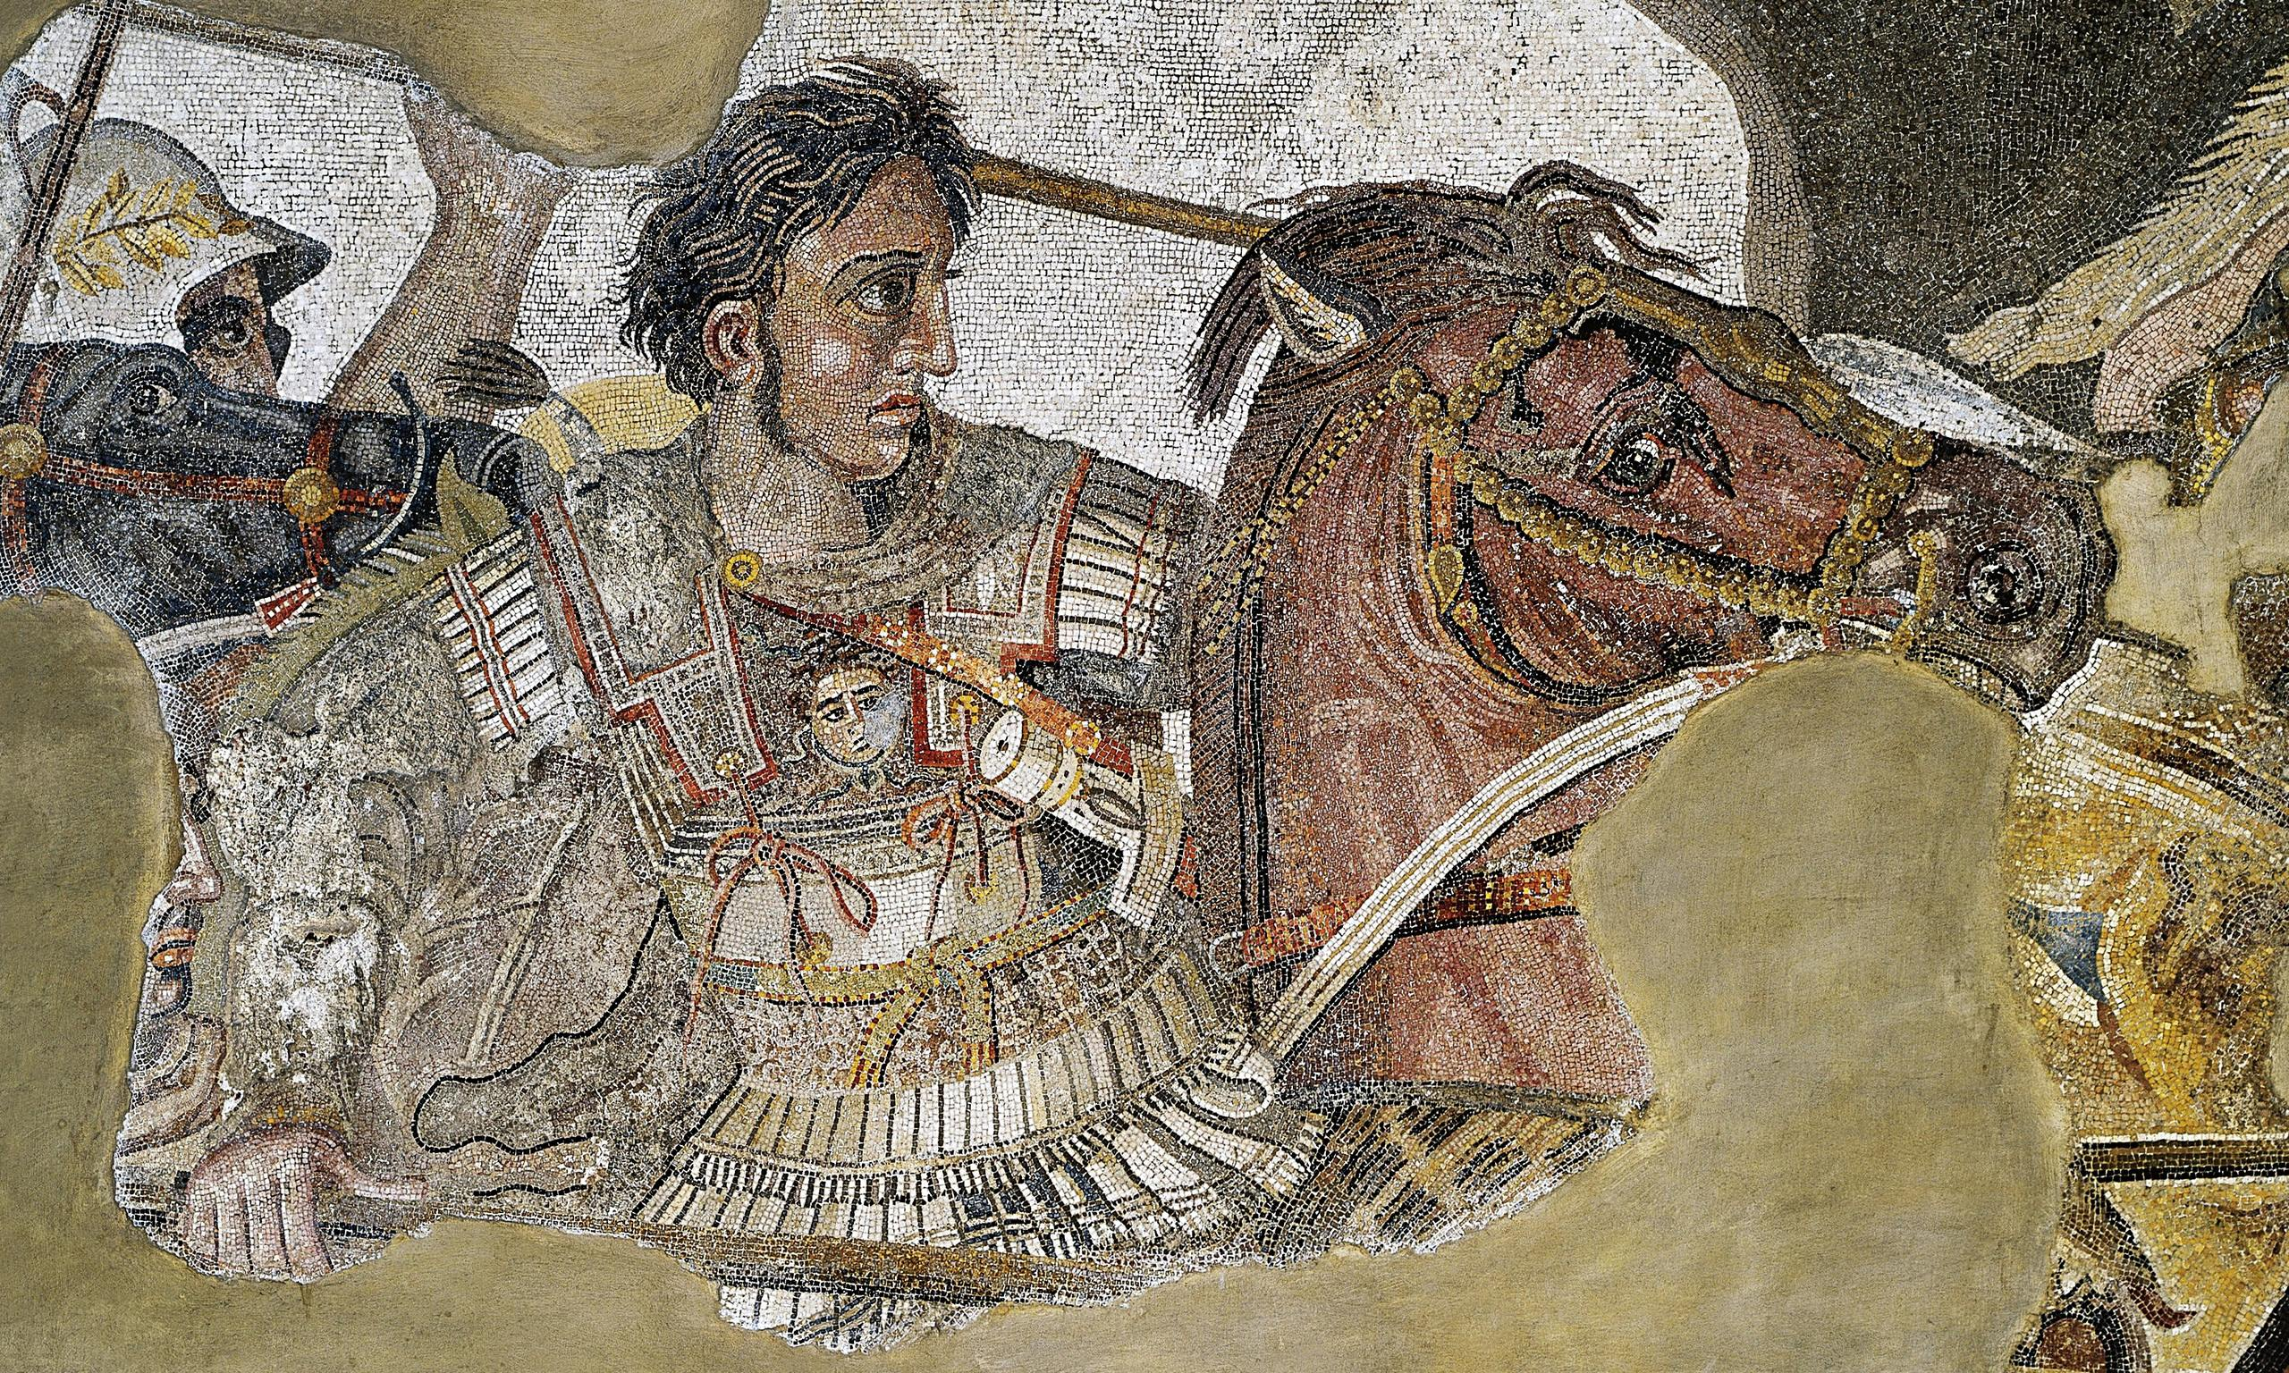
Granicus and Asia Minor
Goal/s:
identify the events of the battle of granicus
Describe atg’s battle strategy
Week 9 Lesson 3 – unit 2
Ms Barrie

Slide 2
In 334 BCE, Alexander the Great and his army faced the Persian forces of Darius III at the Battle of Granicus River. This would be Alexander's first major victory against the Persian king. By using a unique strategy, he was able to win decisively against Darius III and secure his place as one of history's greatest military commanders.

Slide 3
So…
Whats the situation?

Slide 4
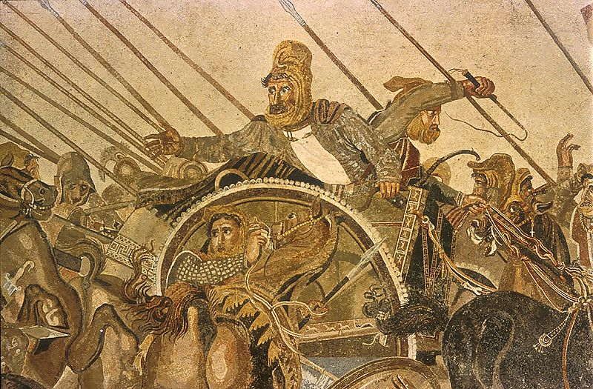
Darius III of Persia
So… what's the situation?
King of Persia, one of the largest empires in the world at that time.
He had a massive army that was well-trained and equipped.
On the other hand, Alexander's army was smaller and relatively inexperienced.
In addition, Darius III had the advantage of fighting on his home turf.

Slide 5
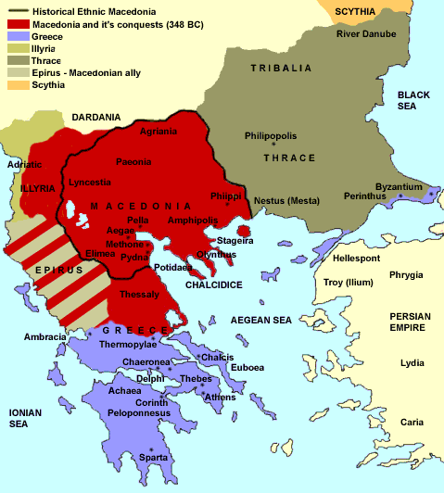

Slide 6
Alexander’s Involvement
So… what's the situation?
Alexander had only just become king of Macedon in 336 BC, after the assassination of his father Phillip II.
He was only 22 years old when he faced Darius III at Granicus River. Despite being outnumbered and outmatched, Alexander was determined to defeat the Persian king.
Given these circumstances, it would have been easy for Alexander to lose hope and give up before even engaging in battle. However, he didn't let this deter him.
Instead, he formulated a plan that would allow him to take on Darius III and win.

Slide 7
ACTIVITY – Watch the following video
https://www.youtube.com/watch?v=agwEKFXiJ20&ab_channel=GreatMilitaryBattles
Write down 5 dot-points from the video
KEY INFORMATION

Slide 8
FIRST STEP: Invade Asia Minor
ATG - invade Asia Minor (present-day Turkey).
May of 334 BCE, ATG & his army crossed the Hellespont (present-day Dardanelles) into Persian territory.
ATG visited the ruins of the ancient city of Troy and paid homage to the Trojan king Priam and offered sacrifices to the gods
this was a symbolic gesture, as it established Alexander as the new Achilles - the great hero of Greek mythology.
ATG and his army marched inland towards Granicus River.
Along the way, they passed through several cities that surrendered to them without a fight. The people of these cities welcomed Alexander as their liberator from Persian rule.
He reached Granicus River - Alexander had built up a large force of allies and supporters. He also had momentum on his side, as he had yet to be defeated in battle.
Darius III, on the other hand, was facing mounting pressure from all sides. He needed to stop Alexander before he could gain any more ground.

Slide 9
ACTIVITY 2 – The Battle of Granicus
Read through the Information Sheet and complete the activities

Slide 10
ACTIVITY 3 – Comic Strip
Create a Comic Strip of the events of the Battle of Granicus River
These will be displayed!

